Slide 1

Image Classification of Cats and Dogs Using CNN
PRESENTED BY-
TANISHKA RUHELA

Slide 2




Introduction to CNN for Image Classification
Hierarchical Features
Image Task Efficiency
CNNs automatically extract features like edges, textures, and shapes from images, building a robust understanding.
They excel in image classification, object detection, and segmentation, outperforming traditional methods.
Layered Architecture
Automated Learning
Key components include convolutional, pooling, and fully connected layers that process and refine visual information.
CNNs learn features directly from data, eliminating the need for manual, time-consuming feature engineering.

Slide 3
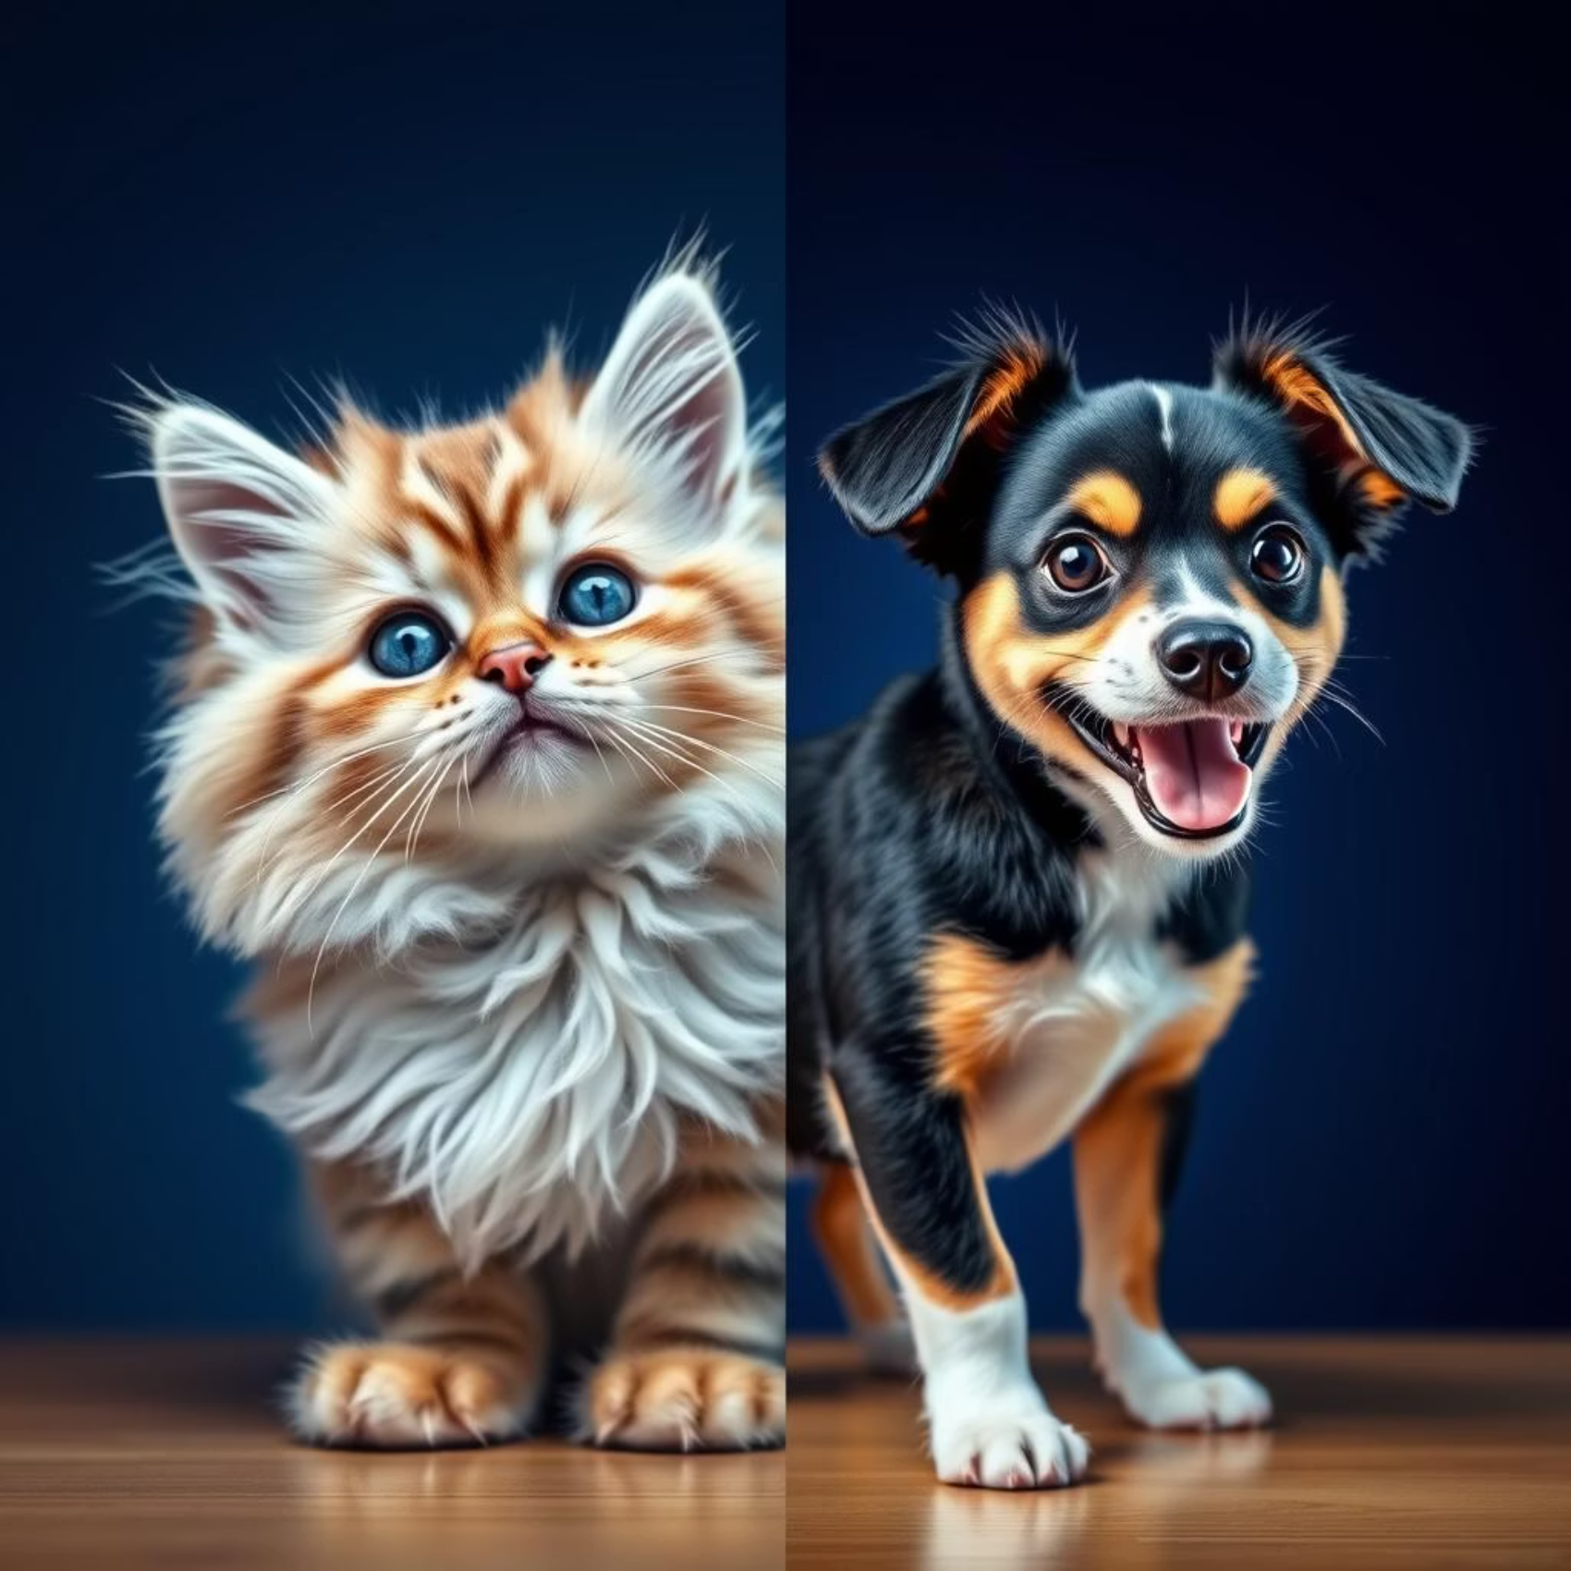
Dataset Overview: Cats vs Dogs
We utilized the Kaggle Dogs vs Cats dataset, a widely recognized benchmark in binary image classification.
This comprehensive dataset contains a total of 25,000 images, providing ample data for robust model training.
It features a balanced distribution of approximately 12,500 cat images and 12,500 dog images, preventing class bias.
Images exhibit considerable variation in size and background complexity, mimicking real-world scenarios.

Slide 4




Data Preprocessing and Augmentation
Image Resizing
Pixel Normalization
All images are uniformly resized to a consistent dimension, typically 200x200 pixels, to standardize input for the CNN.
Pixel values are normalized to a 0-1 range, accelerating convergence during model training and improving stability.
Augmentation Techniques
Dataset Splitting
Data augmentation (rotation, flipping, color jitter) enriches the dataset, enhancing model robustness and preventing overfitting.
The dataset is commonly split into 90% for training and 10% for validation to assess generalization performance effectively.

Slide 5
CNN Model Architecture
Conv2D Layers & ReLU
Multiple Conv2D layers with ReLU activation meticulously extract increasingly complex features from the images.
MaxPooling Layers
MaxPooling layers reduce spatial dimensions, retaining only the most salient information while decreasing computational load.
BatchNormalization
BatchNormalization layers stabilize and accelerate training by normalizing activations in mini-batches.
Dropout Layers
Dropout layers strategically prevent overfitting by randomly deactivating a subset of neurons during training.
Sigmoid Activation
The final layer utilizes a sigmoid activation function, producing a probability score for binary classification (cat or dog).

Slide 6

Model Training Details
Loss Function: Binary Crossentropy
The model optimizes using Binary Crossentropy, ideally suited for two-class prediction problems, penalizing incorrect classifications.
Optimizer: Adam
Adam optimizer is employed for its adaptive learning rate capabilities, ensuring efficient and stable convergence.
Training Epochs & Batch Size
Training typically spans 10-20 epochs, with batch sizes ranging from 32 to 256, balancing training speed and generalization.
Monitoring Metrics
Both training and validation accuracy and loss are rigorously monitored per epoch to track model performance and detect overfitting.

Slide 7
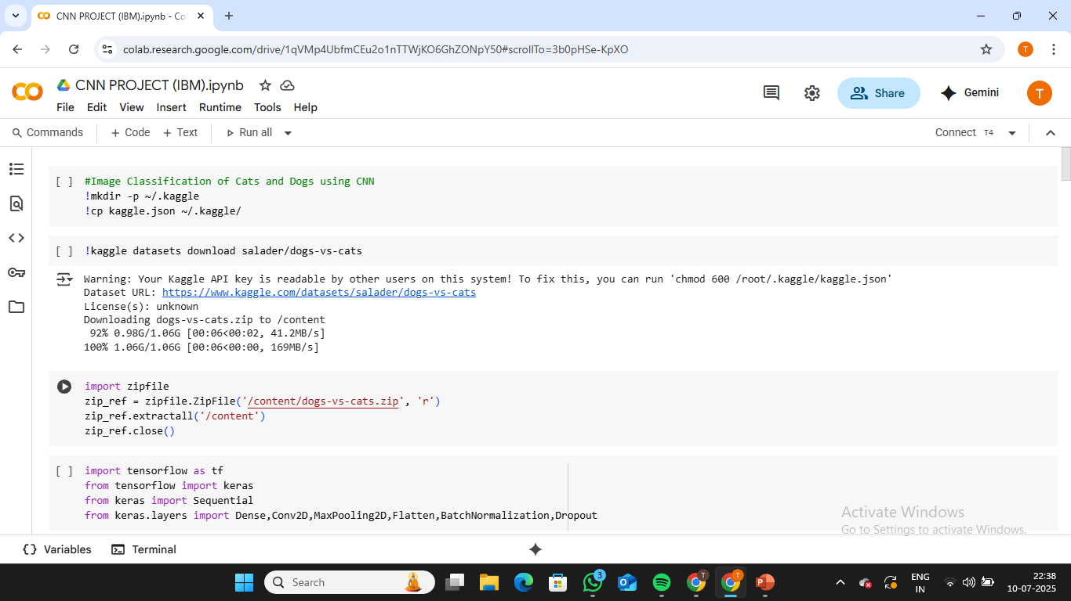
SNAPSHOTS

Slide 8
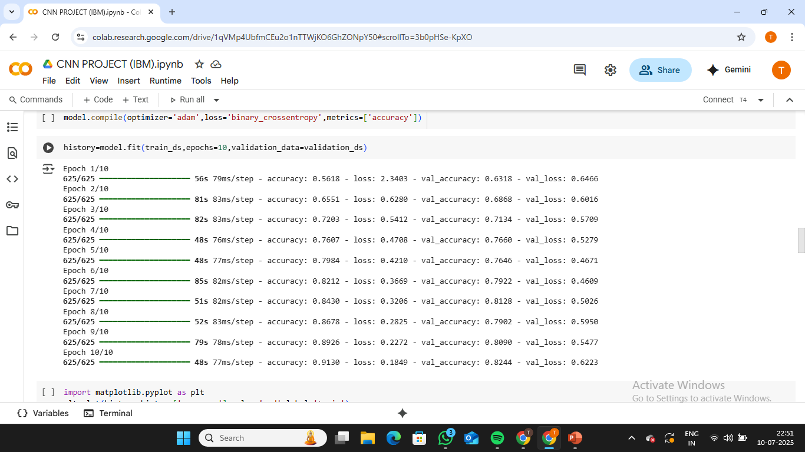

Slide 9
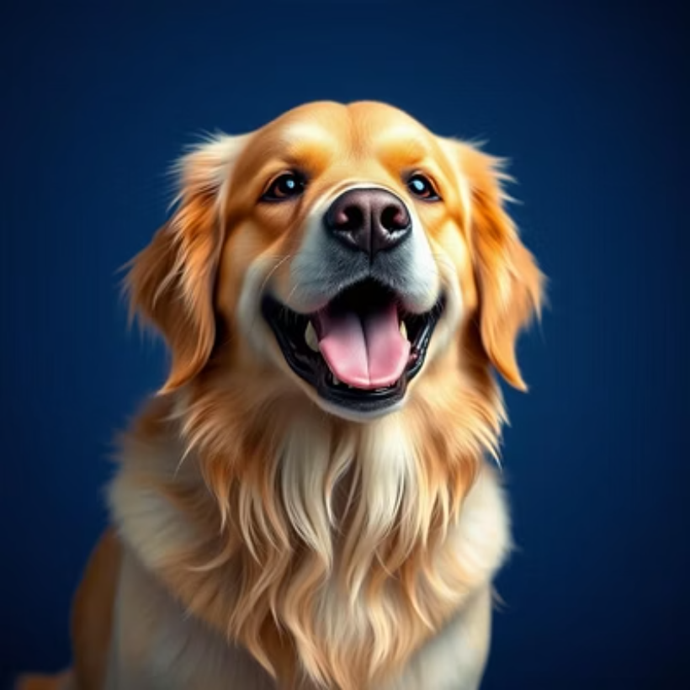
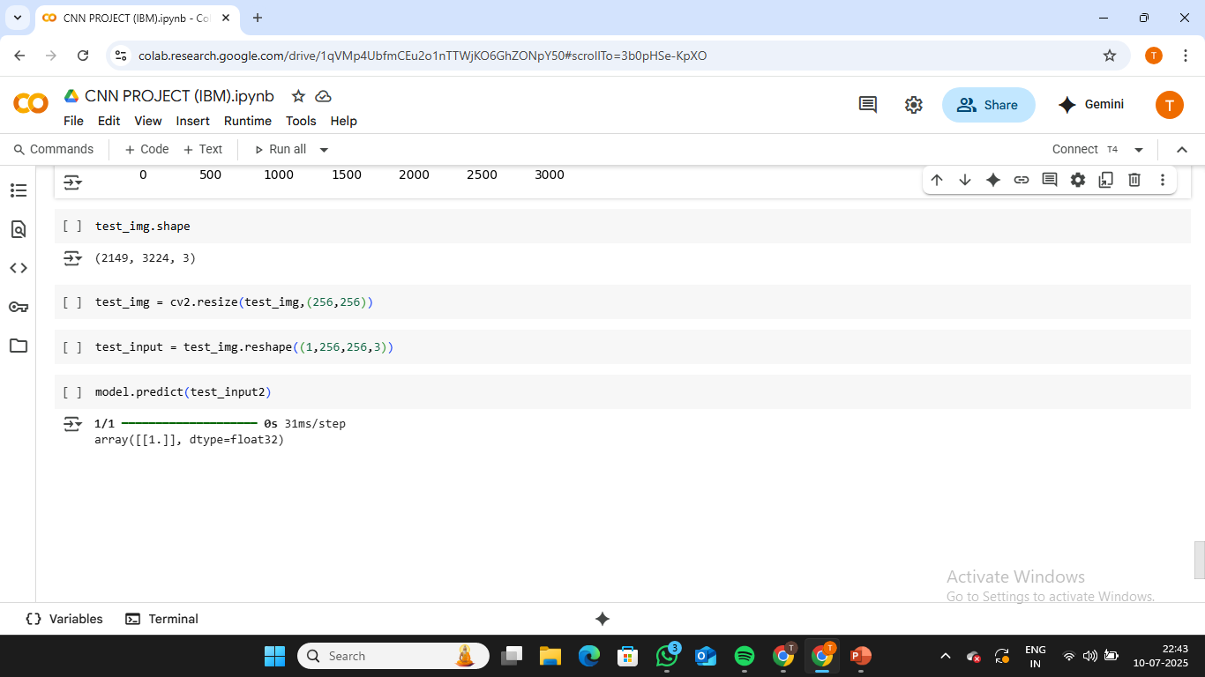

Results and Visualization

Slide 10
Conclusion
Effective Classification
Critical Preprocessing
CNNs prove highly effective for classifying cats and dogs, achieving high accuracy with complex image data.
Robust data augmentation and meticulous preprocessing are paramount for successful model training and performance.
Balanced Architecture
Foundation for Future Work
The CNN architecture effectively balances complexity and safeguards against overfitting, ensuring reliable generalization.
This serves as a strong foundation for tackling more intricate multi-class image classification challenges in diverse domains.

